Slide 1
New York Property
Fraud Analytics
Team 5
Yao Lu
Bei Zhang
Roger Geng

Slide 2

Overview
Data Preprocessing
Variables Used
Algorithms
Results
Contents

Slide 3
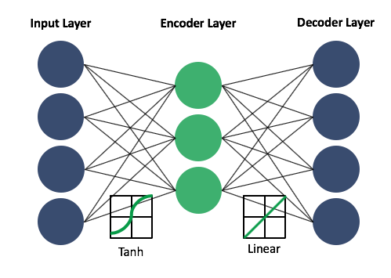

Autoencoder
Loss function: MSE
Optimizer: Adadelta
Input layer
Nodes: 10
Encoder layer
Compression factor: 1.1
Nodes: 10/1.1=9
Activation function: tanh
Output value range: (-1, 1)
Decoder layer
Nodes: 10
Activation function: linear
Output value range: ($−∞,∞$)

Slide 4
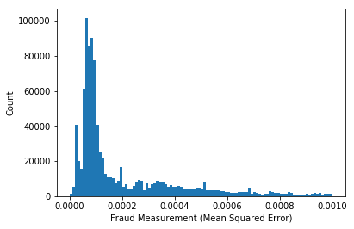
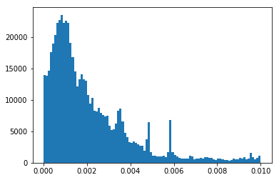
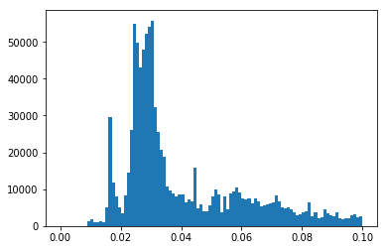
Autoencoder: Fraud Score
MSE
MAE
Root Sum Squared

